Slide 1
Predicate Logic
Dave Touretzky
Read R&N Ch. 8

Slide 2


Monty Python Logic
What do you do with witches?
Burn them!
And what do we burn apart
from witches?
Wood!
So… why do witches burn?
Because they’re made of wood?

Slide 3
What Is Logic?
“The language of thought”:
A systematic method of drawing correct conclusions from premises.
Infer new statements that must be true.
Avoid common fallacies.
Can we formalize all of human thought? No.
How far can we get?

Slide 4
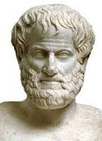
Aristotle: Syllogisms
Aristotle’s approach to correct reasoning was based
on the syllogism: major premise, minor premise, conclusion.
All men are mortal. Socrates is a man.
Socrates is a man. Socrates is mortal.
-------------------------- -----------------------------
Socrates is mortal. Some men are mortal.
Aristotle found 19 forms of valid syllogism, but these can be simplified to 8.
Aristotle
384-328 B.C.

Slide 5
Aristotle’s Limitations
Aristotle’s logic only considers unary predicates.
No connectives.
No way to represent relations between objects.
Example (from De Morgan):
All horses are animals.
Therefore, the head of a horse is the head of an animal.

Slide 6
Reasoning About Connectives
Other early forms of logic explored the meaning of connectives such as “and”, “or”, and “not’.
“P or Q” is true.
P is false.
----------------------------------
Therefore Q must be true.
In the 19th century, Boole, De Morgan, Frege, and others contributed to systematizing this kind of reasoning into what we now know as predicate logic, or the first order predicate calculus (FOPC).

Slide 7
Predicate Calculus (FOPC)
A modern form of logic for making deductive inferences about objects and the relationships among them.
Several uses:
  Formalizing bits of mathematics
  Inference in AI systems
  Queries in database systems
More expressive than propositional logic.
But nowhere close to a complete formalization of human reasoning.

Slide 8
Extensions of first order predicate logic
Temporal logic: reasoning about time points and intervals where relations hold
Modal logic: reason about possible worlds by adding modal operators such as “necessarily”, “possibly”
Belief logic: reason about different sets of beliefs individuals may hold, not all of which may agree with reality or with other individuals’ beliefs
Higher-order logic: quantify over predicates
Non-monotonic logic: assume certain things are true in the absence of contradiction
All of these reason by deduction.

Slide 9
Ontology and Epistemology
Ontology: what things are; what is the nature of the world.
In propositional logic: models assign truth values to statements.
In FOPC: models contain objects, functions on objects, and relations between objects.
Temporal logic extends FOPC with times and intervals.
Epistemology: the way things can be known.
In FOPC: statements can be true, false, or unknown.
In other systems we may have probabilities, or degrees of belief.

Slide 10
Beyond Deduction: Inductive Inference
A physicist, a mathematician, and a philosopher taking a train through Scotland see a black sheep standing in a field.
Physicist: “Scottish sheep are black!”
Mathematician: “Some Scottish sheep are black.”
Philosopher: “On at least one day in Scotland, there exists at least one sheep
that is black... on at least one side.”
____________________
Inductive reasoning is not guaranteed to be correct… but it’s the basis of the natural sciences.

Slide 11
Reasoning About Abstract or Imprecise Concepts
Predicate logic’s inference rules work only for well-defined relations among discrete objects, based on concepts such as equality and set membership.
Many statements resist such simple formalization:
“Clothes make the man.”
“Revenge is a dish best served cold.”
“He has his father’s nose and his mother’s smile.”
“The unexamined life is not worth living.”

Slide 12
What’s wrong with these formulations?
“Clothes make the man.”
Make(clothes, man)
∃m Man(m) ∧ Make(clothes,m)

Slide 13
Even “father of” is problematic in the real world.
Biological father
Legal father
Adoptive father
Step-father
“Presumptive father”
Charles Babbage is the father of the digital computer.
“Success has many fathers, but failure is an orphan.”

Slide 14
Syntax of FOPC (1 of 2)
Sentence →AtomicSentence | ComplexSentence
AtomicSentence →Predicate | Predicate(Term, …) | Term = Term
Term →Constant | Variable | Function(Term, …)
Examples of terms:
socrates
x
father(isaac)
Examples of atomic sentences:
P
Q(x)
Mortal(socrates)
father(isaac) = abraham

Slide 15
Syntax of FOPC (2 of 2)
ComplexSentence →( Sentence ) | [ Sentence ]
| ¬ Sentence
| Sentence ∧ Sentence
| Sentence ∨ Sentence
| Sentence ⇒ Sentence
| Sentence ⇔ Sentence
| Quantifier Variable,... Sentence
Quantifier →∀ | ∃
Example: ∀x [ Man(x) ⇒ Mortal(x) ] “All men are mortal.”

Slide 16
Concise Wumpus World Axioms Using Quantifiers
Square([1,1]), Square([1,2]), Square([2,1]), etc.
∀x,y [ Square([x,y]) ∧ Square([x+1,y]) ⇒ Adjacent([x,y],[x+1,y]) ]
∀x,y [ Square([x,y]) ∧ Square([x,y+1]) ⇒ Adjacent([x,y],[x,y+1]) ]
∀r,s [ Adjacent(r,s) ⇔ Adjacent(s,r) ]
∀s [ Breezy(s) ⇔ ∃r Adjacent(r,s) ∧ Pit(r) ]
∀r [ Pit(r) ⇒ ∀s [ Adjacent(r,s) ⇒ Breezy(s) ] ]
∀s [ Stench(s) ⇔ ∃r Adjacent(r,s) ∧ Wumpus(r) ]
∀r [ Wumpus(r) ⇒ ∀s [ Adjacent(r,s) ⇒ Stench(s) ] ]

Slide 17
Difference between predicates and functions
Predicates describe relations between constants. They are true or false.
FatherOf(abraham, isaac)
Functions are a way of referring to constants without using their names.
father(isaac) = abraham
HusbandOf(father(isaac), sarah)
Should we define “father of” as a predicate or a function? Could do both.
∀x FatherOf(father(x), x)
∀x,y [ (father(x) = y) ⇔ FatherOf(y,x) ]

Slide 18
Functions can give us an infinity of constants
One version of Peano’s axioms of arithmetic:
Natural(0) “0 is a natural number.”
∀n [ Natural(n) ⇒ Natural(s(n)) ] “The successor of a natural # is a natural #.”
¬∃x [ s(x) = 0 ] “0 is not the successor of any number.”
∀n Sum(n, 0, n) “0 is the additive identity.”
∀m,n,p [ Sum(m, n, p) ⇒ Sum(n, m, p) ] “Sum is commutative.”
∀m,n,p [ Sum(m, n, p) ⇒ Sum(s(m), n, s(p)) ] “Inductive defn. of addition.”

Slide 19
Relationships between quantifiers
∀x P(x) ≡ ¬ ∃x ¬P(x) “Every thing is P” means “No thing is not P”
∀x ¬P(x) ≡ ¬ ∃x P(x) “Every thing is not P” means “No thing is P”
¬ ∀x P(x) ≡ ∃x ¬P(x) “Not every thing is P” means “Some thing is not P”
∃x P(x) ≡ ¬ ∀x ¬P(x) “Some thing is P” means “Not every thing is not P”

Slide 20
Order of quantifiers is important
∀x ∃y Loves(x,y) “Everybody loves somebody.”
∃y ∀x Loves(x,y) “There is someone who is loved by everyone.”

Slide 21
FOPC and equality
Classical FOPC does not include equality. We could try to axiomatize it:
∀x Equal(x,x)
∀x,y Equal(x,y) ⇔ Equal(y,x)
∀x,y,z Equal(x,y) ∧ Equal(y,z) ⇒ Equal(x,z)
However, this would not achieve the necessary substitutions:
from P(a) and Equal(a,b) we cannot derive P(b).
We could use higher order logic:
∀P,x,y P(x) ∧ x=y ⇒ P(y)
But what we really need are special inference rules for equality.

Slide 22
FOPC and arithmetic
Classical FOPC does not include arithmetic.
But it is common to extend it with basic arithmetic operations + - × /
and operators = ≠ < > ≤ ≥
This is simply a notational convenience.

Slide 23
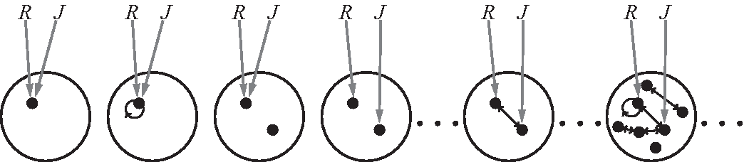
Models in FOPC
In propositional logic, models are truth assignments to propositions.
In FOPC models are more complex. They have four components:
A set of objects
A set of functions mapping objects to other objects
A set of relations, each with its own truth table.
An interpretation mapping constant symbols to objects, function symbols to functions, and predicate symbols to relations.
Possible models for a language with two constant symbols,
R and J, and one
binary relation.

Slide 24
Database semantics
For practical applications it can be beneficial to place some constraints on possible models so that certain assumptions are true.
Unique names assumption: every constant symbol maps to a different object in the model.
Closed world assumption: atomic sentences not known to be true are assumed to be false.
Domain closure: the model contains no more objects than are named by the constant symbols.
These assumptions are useful for reasoning about databases (collections of atomic sentences) and for logic programming.

Slide 25
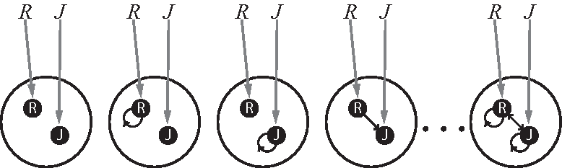
Database models
Possible models of a language with two constants, R and J, and one binary relation, under database semantics. Each constant symbol maps to a distinct object, and the mapping is fixed.
What differs between models is the truth table for the binary relation. The truth table has four entries: P(R,R) P(J,J) P(R,J) P(J,R)

Slide 26
Quantifiers and extended interpretations
An interpretation of a model connects constants, function symbols, and predicate symbols to objects, functions, and relations, respectively.
An extended interpretation specifies values for variables as well.
∀x P(x) is true in a model if every extended interpretation of that model is true, i.e., if the relation P holds for every object that x could be mapped to in that model.
∃x P(x) is true in a model if there is at least one extended interpretation of that model in which x is mapped to an object for which P holds.

Slide 27
Validity and Decidability
Validity is defined as in propositional logic:
A sentence in FOPC is valid if it is true in all possible models.
But decidability is a different matter:
Validity in propositional logic is decidable. We can tell in finite time whether or not a sentence is valid. (How?)
Validity in FOPC is semidecidable: if a sentence is valid, we can confirm that in finite time. But if it is not valid, we cannot always determine that.
This is related to the Halting Problem.

Slide 28
Interpretation of Sentences
What does P(a) mean?
Is P(a) valid?

Slide 29
Implicit Quantifiers
What does P(x) mean? Does it have an interpretation?
What could it mean?
∀x P(x)
∃x P(x)
Which makes more sense?

Slide 30
Application: The Kinship Domain
Translate the following kinship axioms into English:
∀x [ Male(x) ⇔ ¬Female(x) ]
∀x,y [ Mother(x,y) ⇔ Female(x) ∧ Parent(x,y) ]
∀x,y [ Husband(x,y) ⇔ Male(x) ∧ Spouse(x,y) ]
∀x,z [ Grandparent(x,z) ⇔ ∃y Parent(x,y) ∧ Parent(y,z) ]
∀x,y [ Parent(x,y) ⇔ Child(y,x) ]
∀x,y [ Sibling(x,y) ⇔ ∃p Child(x,p) ∧ Child(y,p) ∧ x ≠ y ]

Slide 31
Kinship Problems
Give a definition for Cousin(x,y)
Give a definition for Ancestor(x,y)
What is this in English?
Brother(x,y) ∧ ∃p,q [ Mother(p,x) ∧ Mother(q,y) ∧ p ≠ q ]

Slide 32
What kinds of inference can we do in FOPC?
Ask whether an atomic sentence is true.
  Mother(sarah, isaac) ?
  For Horn theories this can be answered efficiently.
Ask whether an arbitrary sentence is true.
  Mother(diana, harry) ∨ ¬Mother(diana, camilla) ?
  We may know the disjunction is true without knowing which literal is true.
  No polynomial time algorithm. This requires full-blown theorem proving.
Ask for variable bindings that would make a sentence true.
  ∃x,y,z,w Mother(x,y) ∧ Husband(y,z) ∧ Ancestor(w,x) ∧ Ancestor(w,z)

Slide 33
Derivations in FOPC
Prove: ∀x P(x) ∨ ¬P(x)
Proof by contradiction:
¬ ∀x P(x) ∨ ¬P(x) Assert the negation of what is to be proved.
∃x ¬( P(x) ∨ ¬P(x) ) Bring negation inside the quantifier.
∃x ¬P(x) ∧ P(x) Bring negation inside the disjunction
¬P(s₁) ∧ P(s₁) Skolemization
¬P(s₁) And-elimination
P(s₁)
contradiction

Slide 34
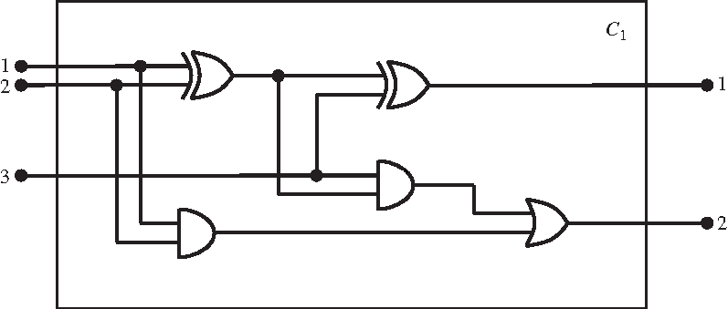
Electronic Circuit: Full Adder
g₁
g₂
g₄
g₅
g₃

Slide 35
Circuit Components
Circuit(c₁)
Arity(c₁, 3, 2)
Gate(g₁), type(g₁) = xor
Gate(g₂), type(g₂) = xor
Gate(g₃), type(g₃) = and
Gate(g₄), type(g₄) = and
Gate(g₅), type(g₅) = or
g₁
g₂
g₄
g₃
g₅

Slide 36
Circuit Connectivity
Connected(out(1,g₁), in(1,g₂)) Connected(in(1,c₁), in(1,g₁))
Connected(out(1,g₁), in(2,g₄)) Connected(in(1,c₁), in(1,g₃))
Connected(out(1,a₄), in(1,g₅)) Connected(in(2,c₁), in(2,g₁))
Connected(out(1,g₃), in(2,g₅)) Connected(in(2,c₁), in(1,g₃))
Connected(out(1,g₂), out(1,c₁)) Connected(in(3,c₁), in(2,g₂)
Connected(out(1,g₅), out(2,c₁)) Connected(in(3,c₁), in(1,g₄))
out(1,c₁) is the sum bit of the adder
out(2,c₁) is the carry bit of the adder

Slide 37
Circuit Axioms 1
Connected terminals have the same signal:
∀t₁,t₂ [ Terminal(t₁) ∧ Terminal(t₂) ∧ Connected(t₁,t₂) ⇒
signal(t₁) = signal(t₂) ]
A terminal’s signal is either 1 or 0:
∀t [ Terminal(t) ⇒ signal(t) = 1 ∨ signal(t) = 0 ]
Connectedness is symmetric:
∀t₁,t₂ [ Connected(t₁,t₂) ⇔ Connected(t₂,t₁) ]

Slide 38
Circuit Axioms 2
Rule for AND gates:
∀x [ Gate(x) ∧ type(x) = and ⇒
[ signal(out(1,x)) = 0 ⇔ ∃i signal(in(i,x)) = 0 ] ]
Rule for OR gates:
∀x [ Gate(x) ∧ type(x) = or ⇒
[ signal(out(1,x)) = 1 ⇔ ∃i signal(in(i,x)) = 1 ] ]
Rule for XOR gates:
∀x [ Gate(x) ∧ type(x) = xor ⇒
[ signal(out(1,x)) = 1 ⇔ signal(in(1,x)) ≠ signal(in(2,x) ] ]

Slide 39
Circuit Axioms 3
Closed world assumption regarding terminals:
∀x [ Gate(x) ⇒ Terminal(in(1,x)) ∧ Terminal(in(2,x)) ∧ Terminal(out(1,x)) ∧
∀i [ (i>2 ⇒ Terminal(in(i,x)) = nothing) ∧
(i>1 ⇒ Terminal(out(i,x)) = nothing) ] ]
Uniqueness of objects:
∀x,t [ Gate(x) ∧ Terminal(t) ⇒
x ≠ t ≠ 0 ≠ 1 ≠ AND ≠ OR ≠ XOR ≠ nothing ]

Slide 40
Answering questions about the adder
What combination of inputs would cause the sum to be 0 and the carry to be 1?
∃i₁,i₂,i₃ signal(in(1,c₁)) = i₁ ∧
signal(in(2,c₁)) = i₂ ∧
signal(in(3,c₁)) = i₃ ∧
signal(out(1,c₁)) = 0 ∧
signal(out(2,c₂) = 1
What are the possible sets of input/output values for this circuit?
∃i₁,i₂,i₃,o₁,o₂ ...

Slide 41
How to do automated inference in FOPC
Reduction to propositional inference
Horn theories:
  Forward chaining
  Backward chaining
Resolution
Next lecture

Slide 42
Reduction to propositional inference
Universal instantiation: let α be any sentence and g any ground term.
∀v α
---------------------
SUBST({v/g}, α)
Existential instantiation (Skolemization): let s be a unique Skolem constant.
∃v α
--------------------
SUBST({v/s}, α)

Slide 43
Infinite models
When functions are included, models are infinite.
Can’t convert a FOPC theory to a finite propositional theory.
But…
Herbrand proved that if a sentence is entailed by an FOPC theory, there is a proof involving just a finite subset of the propositionalized knowledge base.
This is theoretically interesting, but not a practical way to do inference.
For better approaches, read R&N chapter 9.

